Slide 1
Natural Language ToolKit
Mohammed K Jumaah
Mohammed Q Kareem
Asst. Prof. Hadi Saboohi
Postdoctoral Research Fellow, University of Malaya

Slide 2
OUTLINE
What is NLP?
Application of NLP
What is NLTK?
NLTK Implementation
Syntax

Slide 3
WHAT IS NATURAL LANGUAGE PROCESSING (NLP)?
Natural Language Processing (NLP) is an area of computer science and artificial intelligence concerned with interactions between computer and human(natural) language.

Slide 4
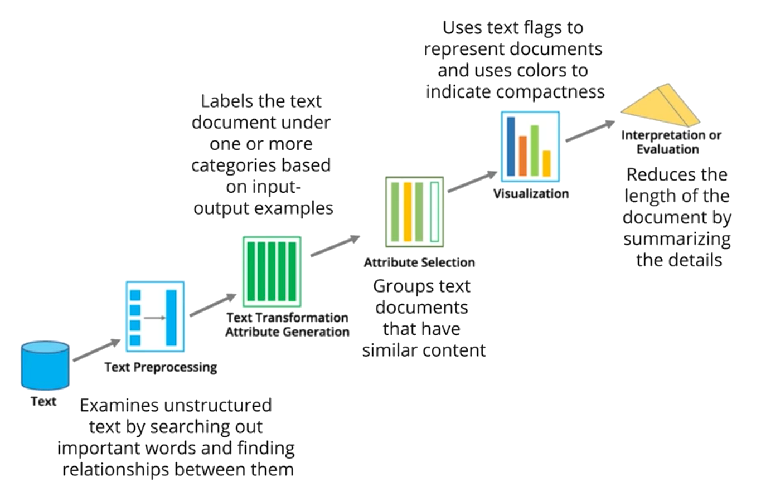
FLOW OF TEXT MINING

Slide 5
APPLICATIONS OF NLP
Natural Language Processing is powering many industries with its advanced Deep Learning Algorithms like transformers, language models(GPT-3), RNNs, LSTMs, and many more.
NLP is used in,
Sentimental Analysis
Chatbots
Virtual Assistants
Speech Recognition
Machine Translation
Advertise Matching
Information Extraction
Grammatical error detection
Fake news detection
Text Summarize

Slide 6
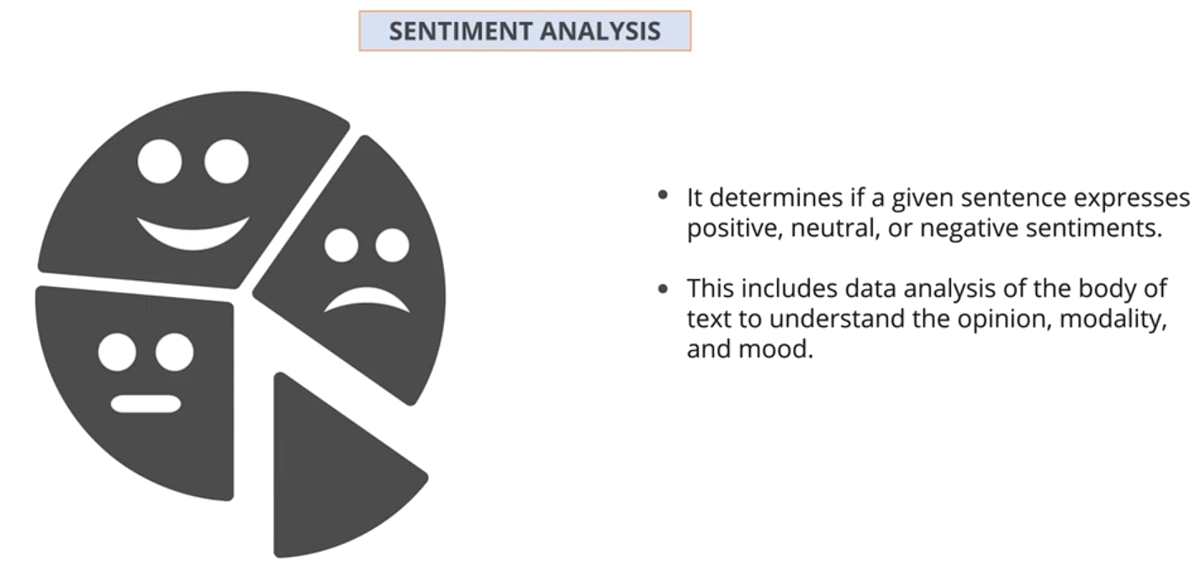
APPLICATIONS OF NLP CONT.

Slide 7
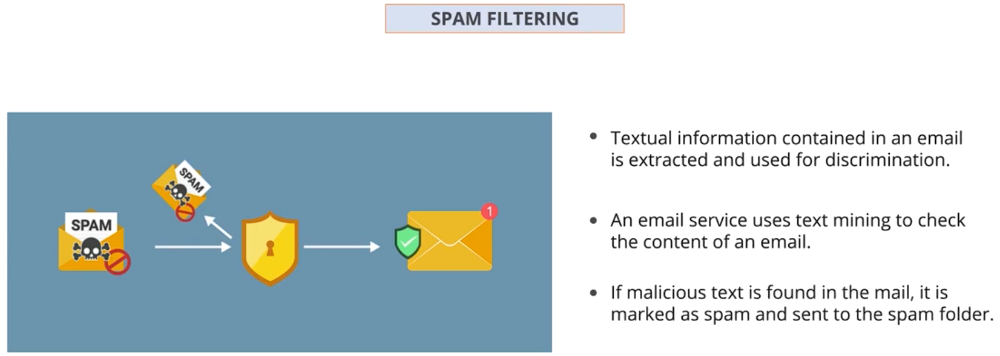
APPLICATIONS OF NLP CONT.

Slide 8
LIBRARIES FOR NLP
Here are some of the libraries for leveraging the power of Natural Language Processing.
Natural Language Toolkit (NLTK)
spaCY
Gensim
Standford CoreNLP
TextBlob

Slide 9
WHAT IS A NATURAL LANGUAGE TOOLKIT (NLTK)?
Natural Language Toolkit, or more commonly NLTK, is a suite of libraries and programs for symbolic and statistical natural language processing (NLP) for English written in the Python programming language. It was developed by Steven Bird and Edward Loper in the Department of Computer and Information Science at the University of Pennsylvania.

Slide 10
WHERE CAN WE USE IT?
We can process raw texts and extract meaningful features from them. It also offers text analyzing models, feature-based grammar, and rich lexical resources for building a complete language model.

Slide 11
PRIMARY GOALS OF NLTK
Simplicity
To provide an intuitive framework and substantial building blocks, giving users a practical knowledge of NLP without getting bogged down in the tedious housekeeping is usually associated with processing annotated language data.
Consistency
To provide a uniform framework with consistent interfaces and data structures, and easily guessable method names.
Extensibility
To provide a structure into which new software modules can be easily accommodated, including alternative implementations and competing approaches to the same task.
Modularity
To provide components that can be used independently without needing to understand the rest of the toolkit.

Slide 12
NLTK MODULES WITH EXAMPLES OF FUNCTIONALITY
Language processing task | NLTK modules | Functionality
Accessing corpora | nltk.corpus | Standardized interfaces to corpora and lexicons
String processing | nltk.tokenize, nltk.stem | Tokenizers, sentence tokenizers, stemmers
Collocation discovery | nltk.collocations | t-test, chi-squared, point-wise mutual information
Part-of-speech tagging | nltk.tag | n-gram, backoff, Brill, HMM, TnT
Classification | nltk.classify, nltk.cluster | Decision tree, maximum entropy, naive Bayes, EM, k-means
Chunking | nltk.chunk | Regular expression, n-gram, named entity
Parsing | nltk.parse | Chart, feature-based, unification, probabilistic, dependency
Semantic interpretation | nltk.sem, nltk.inference | Lambda calculus, first-order logic, model checking
Evaluation metrics | nltk.metrics | Precision, recall, agreement coefficients
Probability and estimation | nltk.probability | Frequency distributions, smoothed probability distributions
Applications | nltk.app, nltk.chat | Graphical concordancer, parsers, WordNet browser, chatbots
Linguistic fieldwork | nltk.toolbox | Manipulate data in SIL Toolbox format

Slide 13
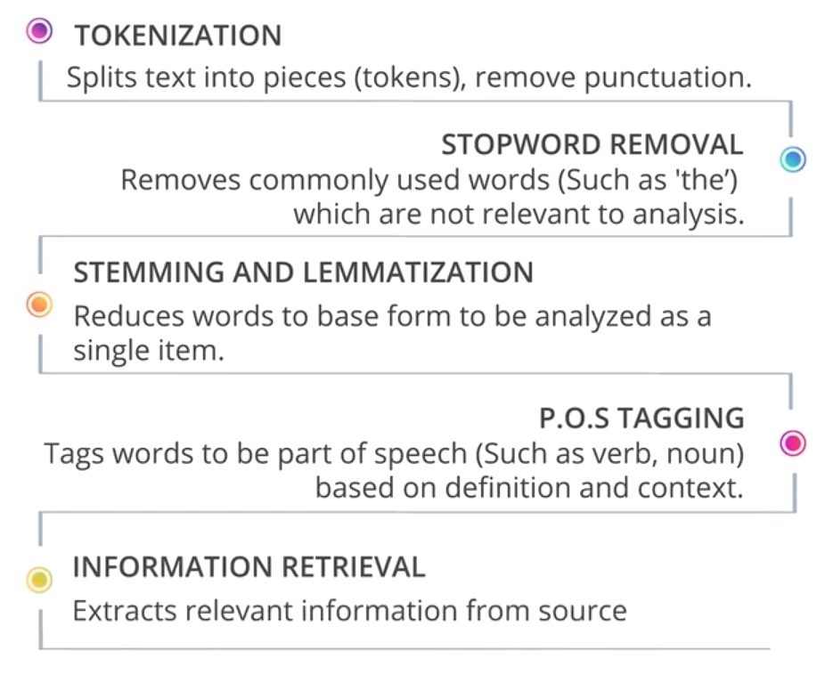
PROCESS WORKFLOW

Slide 14
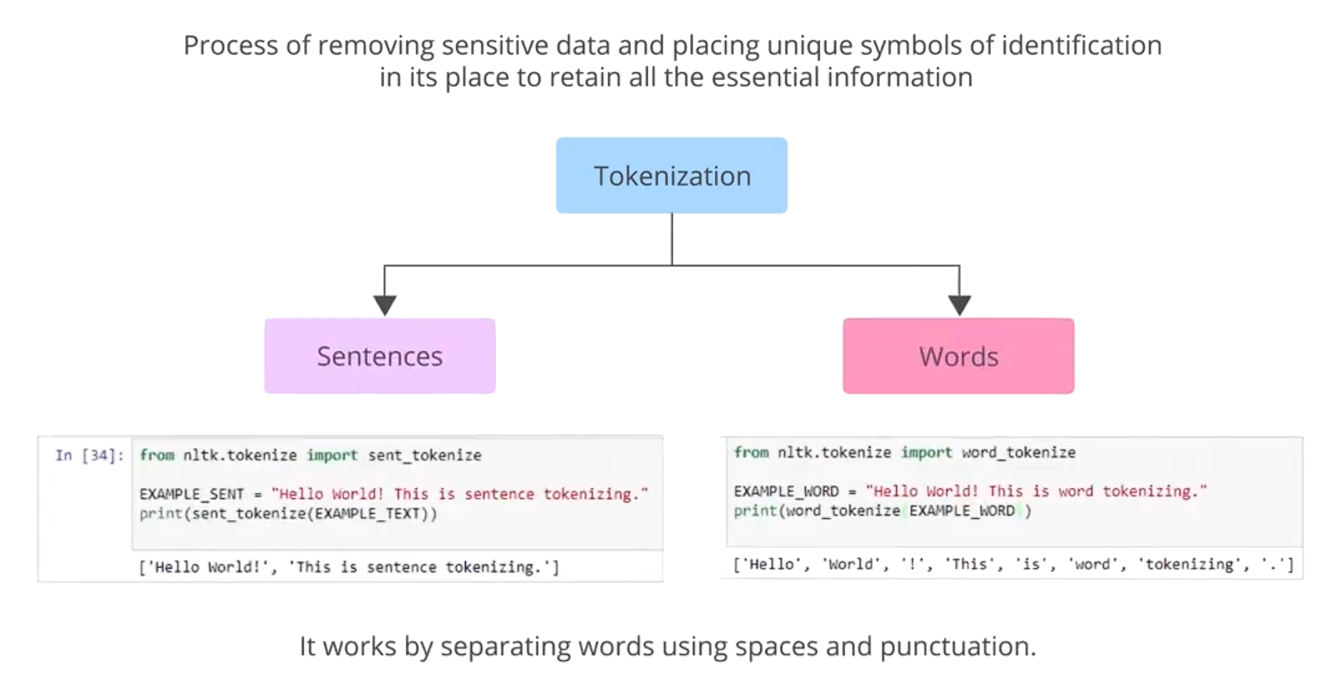
TOKENIZATION

Slide 15
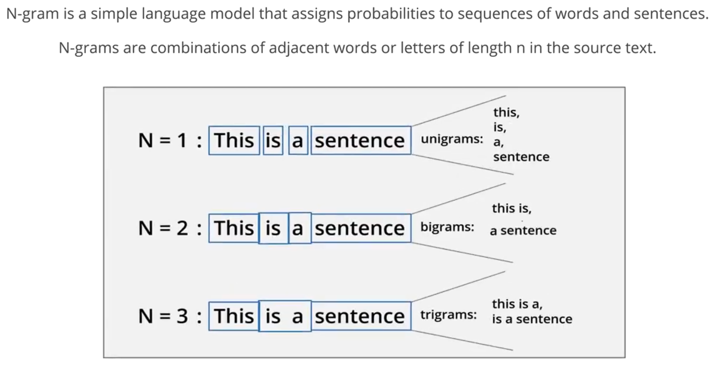
N-grams

Slide 16
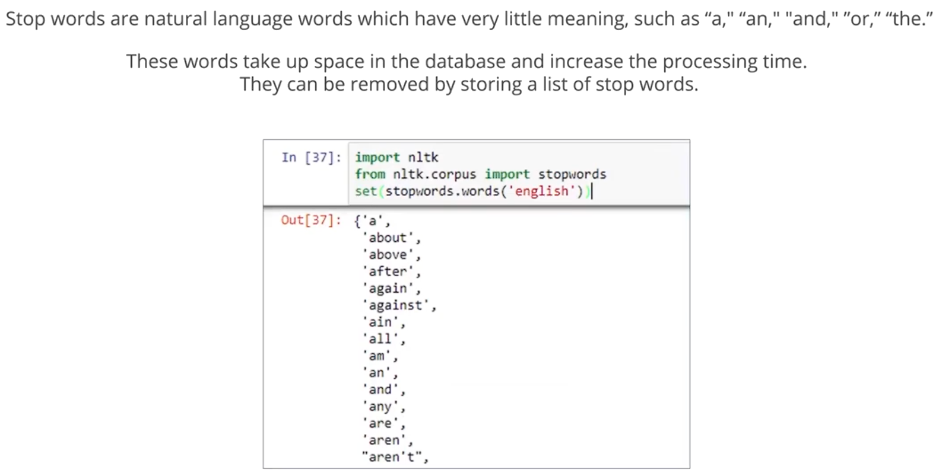
STOP WORD REMOVAL

Slide 17
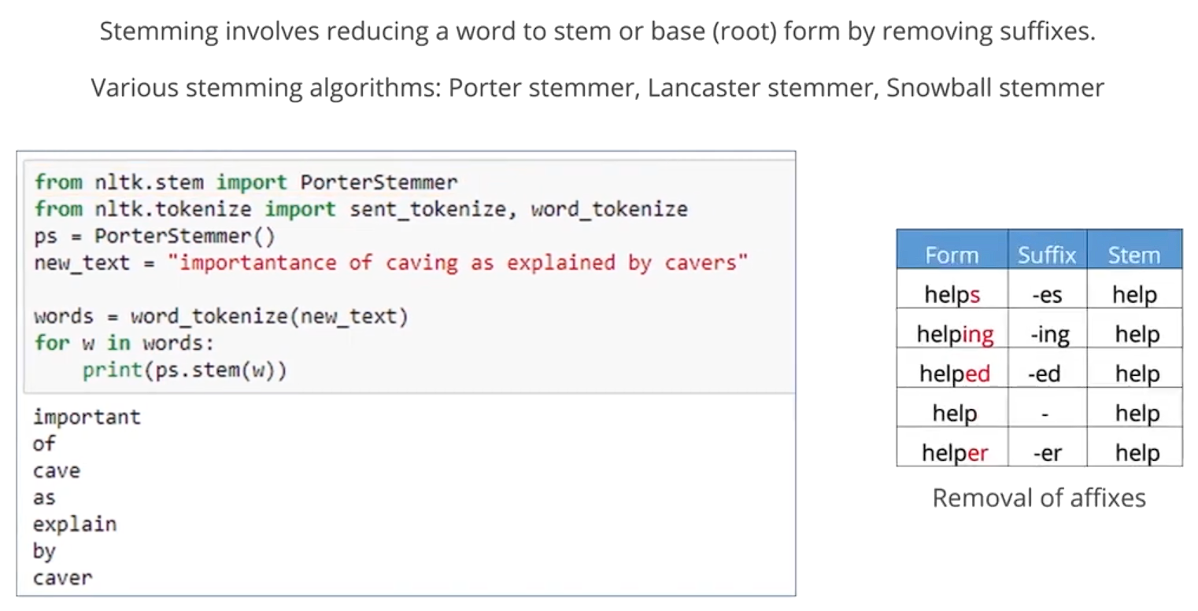
STEMMING

Slide 18
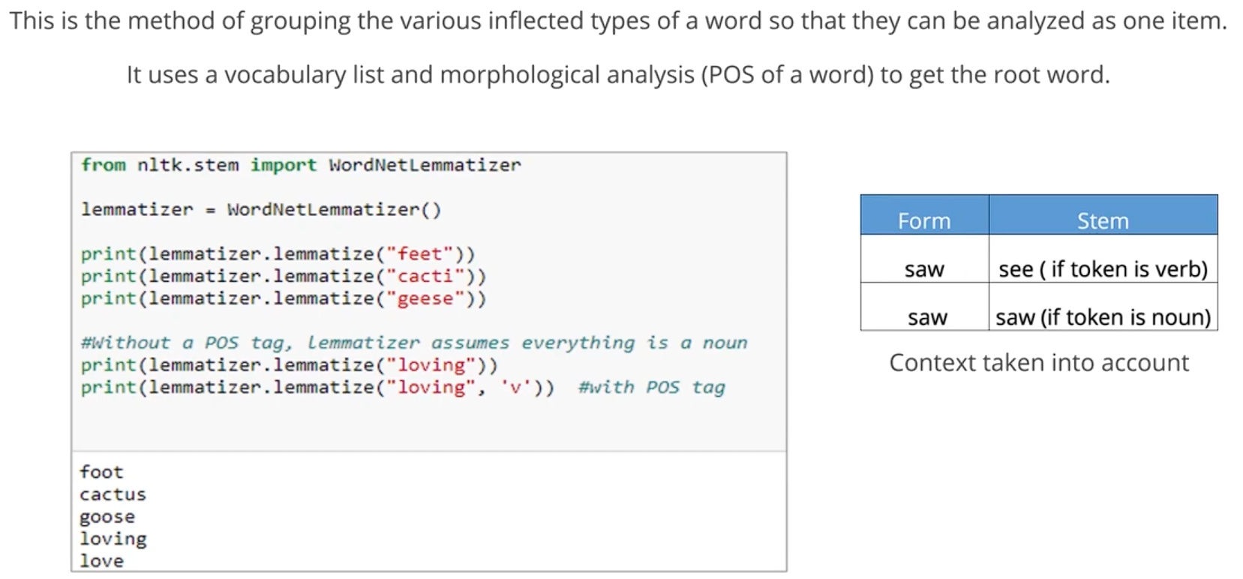
LEMMATIZATION

Slide 19
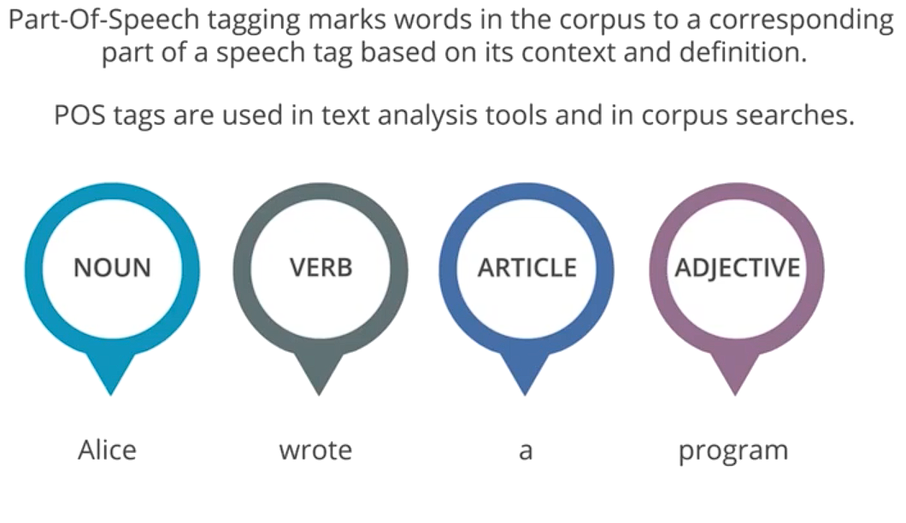
POS TAGGING

Slide 20
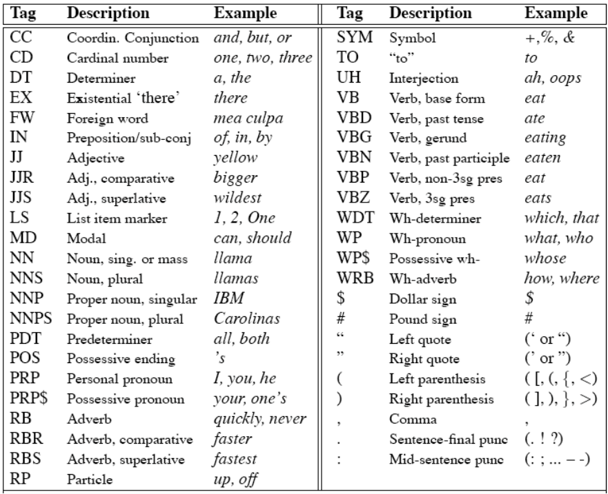
POS TAGS

Slide 21
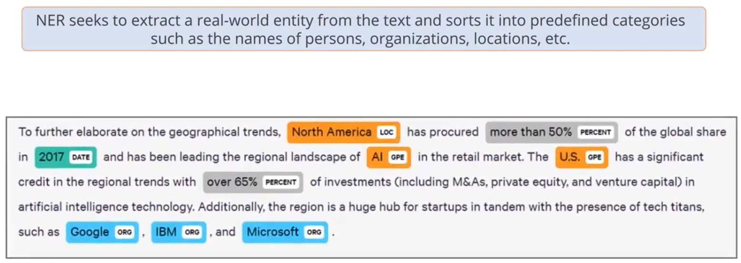
NAME ENTITY RECOGNITION (NER)

Slide 22
NAME ENTITY RECOGNITION (NER) CONT.
Here’s the list of named entity types:
NE Type | Examples
ORGANIZATION | Georgia-Pacific Corp., WHO
PERSON | Eddy Bonte, President Obama
LOCATION | Murray River, Mount Everest
DATE | June, 2008-06-29
TIME | two fifty a m, 1:30 p.m.
MONEY | 175 million Canadian dollars, GBP 10.40
PERCENT | twenty pct, 18.75 %
FACILITY | Washington Monument, Stonehenge
GPE | South East Asia, Midlothian

Slide 23
SYNTAX
Syntax is the grammatical structure of sentences
A language involves constructing phrases and sentences out of morphemes and words.

Slide 24
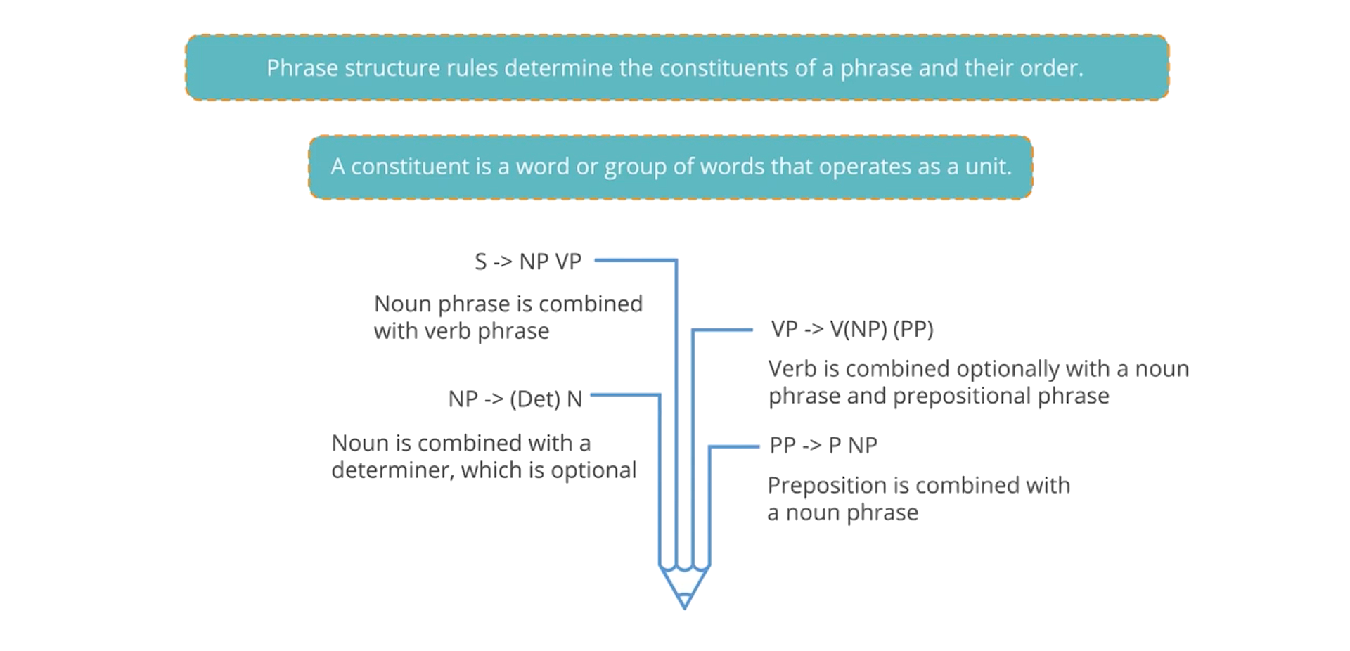
PHRASE STRUCTURE RULES

Slide 25
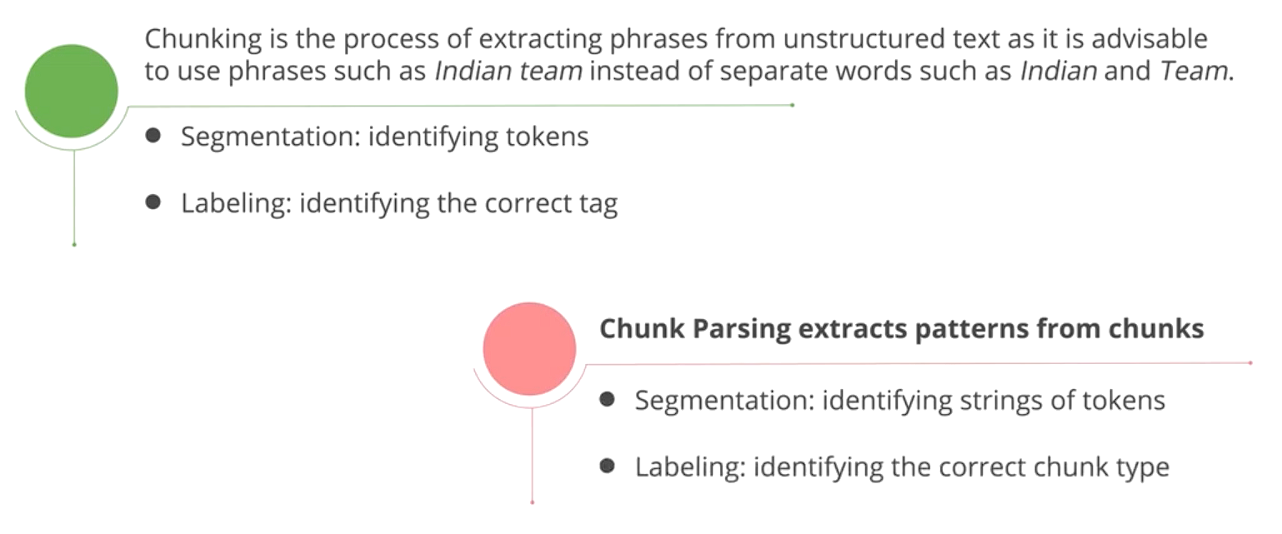
CHUNKING AND CHUNK PARSING

Slide 26
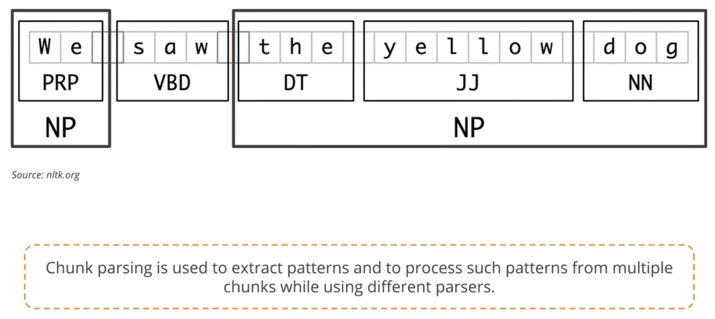
CHUNKING AN EXAMPLE

Slide 27
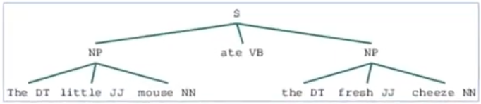
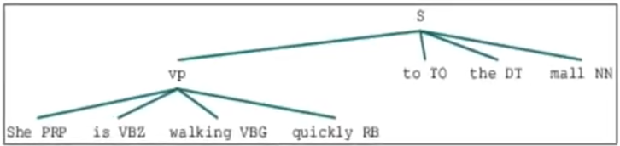
NP & VP CHUNK AND PARSER
“ the little mouse ate the fresh cheeze “
NP
“ She is walking quickly to the mall “
VP

Slide 28
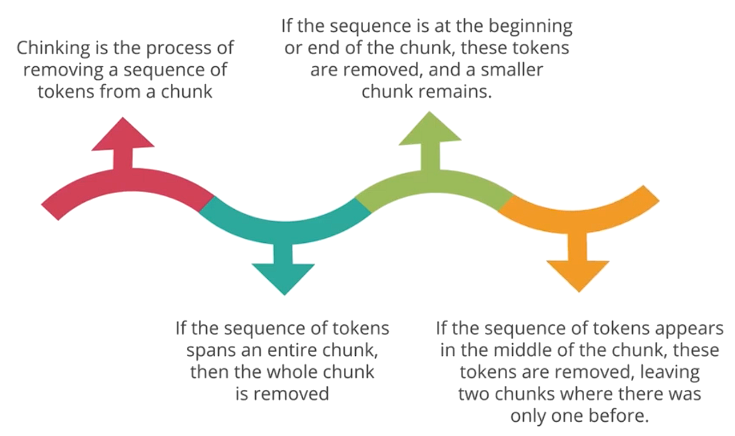
CHINKING

Slide 29
REFERENCES
Statistical Natural Language Processing Part of speech tagging - Çağrı Çöltekin – 2019
Steven Bird, Evan Klein and Edward Loper. Natural Language Processing with Python. O'Reilly Media, Inc.2009. ISBN: 978-0-596-51649-9.
The Application of NLTK Library for Python Natural Language Processing in Corpus Research
https://www.nltk.org/
https://realpython.com/nltk-nlp-python/

Slide 30
Thank you!

